Slide 1



About Us
OUR THEME :-
VOCAL FOr LOCAL
INDIGRO.COM
Team ALPHA X
Harsh Tiwary (EE)
Aman Singh (EE)
Vani Tripathi (ECE)
Priyank Aman (ECE)

Slide 2
WHAT INDIGRO IS ALL ABOUT?
IDEA
POBLEM STATEMENT
Indigro is a initiative built to act as a bridge between Buyers and sellers.
A platform for small Indian industries to channelize their market.
A one stop guide for a tourist to collect some heritage and memories.
Even after years of independence, we have not trusted our indigenous industries, resources and entrepreneurs. We did not trust ourselves.
We handed the baton over to multinational corporations and foreigners. The growth that happened was jobless, faceless and ruthless.
By allowing the import of subsidised Chinese goods, we put several local industries out of business, instead of nurturing them into valuable contributors to society.

Slide 3
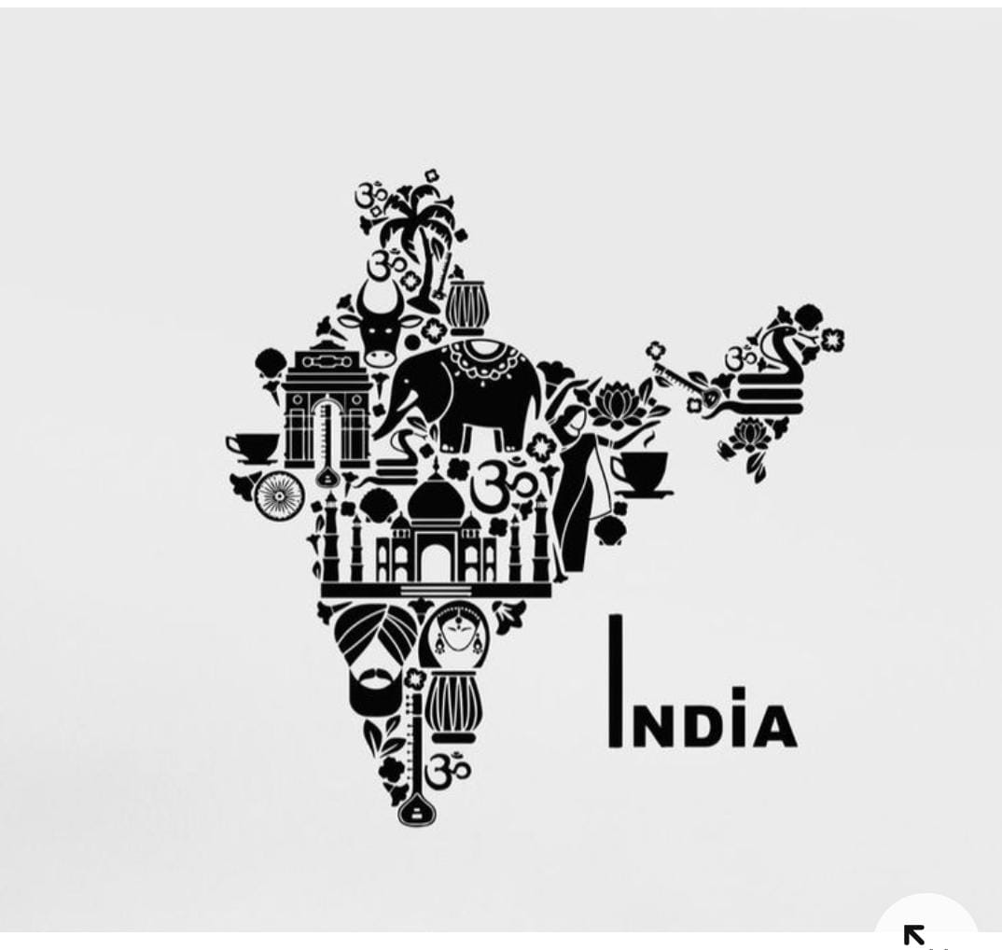
Our Promise
SWADESHIFYING THE WORLD
Here in our website we have created a platform to directly link consumers to local businessman.
It also attracts investors to invest in these local industries and enable them to flourish at global level.
As a small step towards “Aatmanirbhar Bharat”, we want local and traditional artisans and craftsmen to be supported and Indian rich and diverse culture be CELEBRATED.

Slide 4
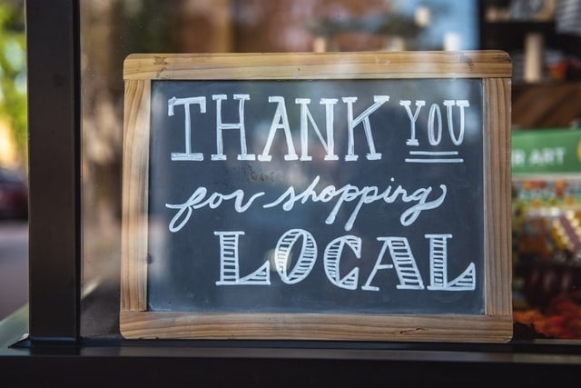

HOW IT WORKS?
Any Local manufacturer registers and gets certified from our team gets a platform showcase his product.
Any tourist login and search the famous regional products along with location and price range to shop.
Traders can contact the industries ,place orders and sell them globally,
INdiGRO is a non profit platform built to provide a small scale industry better reach and knowledge for outsourcing.
TECH STACK

Slide 5

WHAT’S SPECIAL?
INDIGRO acts a guide for a tourist to shop regional products as a part of their memory.
YOU enter your destination algorithm suggest all the famous local products nearby which goes through our quality checks to get a certification tag, along with a price range prediction for tourists .
IF you are a wander lust
then Indigro is a must visit website.
Notes:
Line spacing + Page numbers

Slide 6
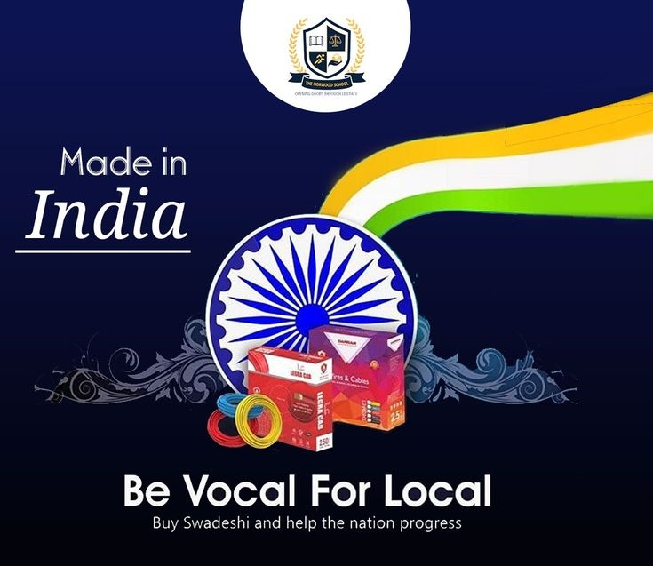
Future works
01 Our future aspiration is to extend this project to all parts of India so that we can feature commodities of various local brands capable of replacing international products.
02 We would also add a feature wherein people can get info about festivals and fairs ongoing in a particular state so that they don’t miss the true traditional Indian essence.

Slide 7

THANK YOU
A VERY special thanks for giving Your valuable time .
We will be pleased to listen to your feedback and remarks.
TEAM APLHA X

